Slide 1
Non-Contiguous Memory Allocation
-Cherry Khosla

Slide 2
What is non-contiguous memory allocation
In non-contiguous memory allocation, different parts of a process is allocated different places in Main Memory
Spanning is allowed
Here a process can be spanned across different spaces in main memory in non-consecutive manner.
There are two techniques we will discuss here
  Paging
  Segmentation

Slide 3
Paging
The main idea behind the paging is to divide each process in the form of pages. The main memory will also be divided in the form of frames.
The basic method for implementing paging involves breaking physical memory into fixed-sized blocks called frames and breaking logical memory into blocks of the same size called pages.

Slide 4
Question
Secondary memory in non-contiguous memory allocation scheme is divided into fixed size blocks called
Pages
Frames

Slide 5
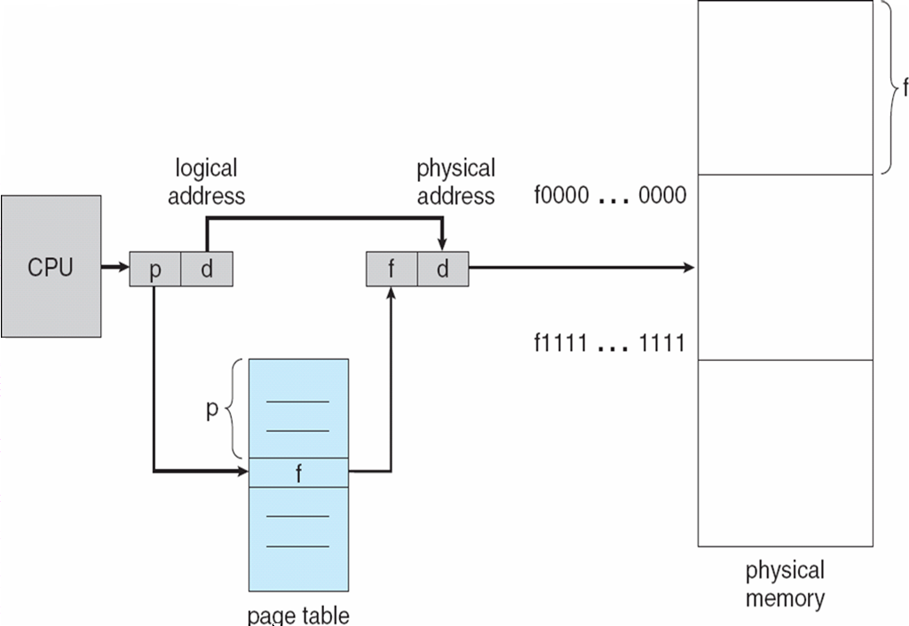

Slide 6


Slide 7

Frame no. X Page size + Page offset

Slide 8
Implementation of Page Table
Each operating system has its own methods for storing page tables.
The hardware implementation of the page table can be done in several ways.
  Use of Registers
  Page-table base register(PTBR)/Page-table length register(PTLR)
  Translation look-aside buffer(TLB)/associative memory

Slide 9
USING PTBR
Page Table is kept in memory
PTBR points to the page table in main memory.
PTLR indicates the size of the page table
In this scheme every data/instruction requires two memory accesses.
Problem with access time.

Slide 10
Using TLB
The CPU’s main memory unit(MMU)stores a cache of recently used mappings from the operating system’s page table. This is called TLB.
The TLB is associative, High-speed memory .Each TLB entry consists of two parts:
  a key (Tag)
  A value
If a page is found in TLB- TLB hit
If it is not there in TLB-TLB miss
Percentage of times that a particular page is found in TLB is called hit ratio.

Slide 11


Slide 12
Effective Access Time
Suppose there is 80% hit ratio
TLB look up takes=5 nano sec
Memory access time is=100 nano sec
EAT=
(TLB time + memory time) * hit ratio + (TLB time + memory time+ memory time) * miss ratio

